Slide 1
Yelp Data Analysis to improve Customer Retention for Restaurants
Professor : Dr. Najam Hassan
Sri Vaishnavi Kudikala

Slide 2
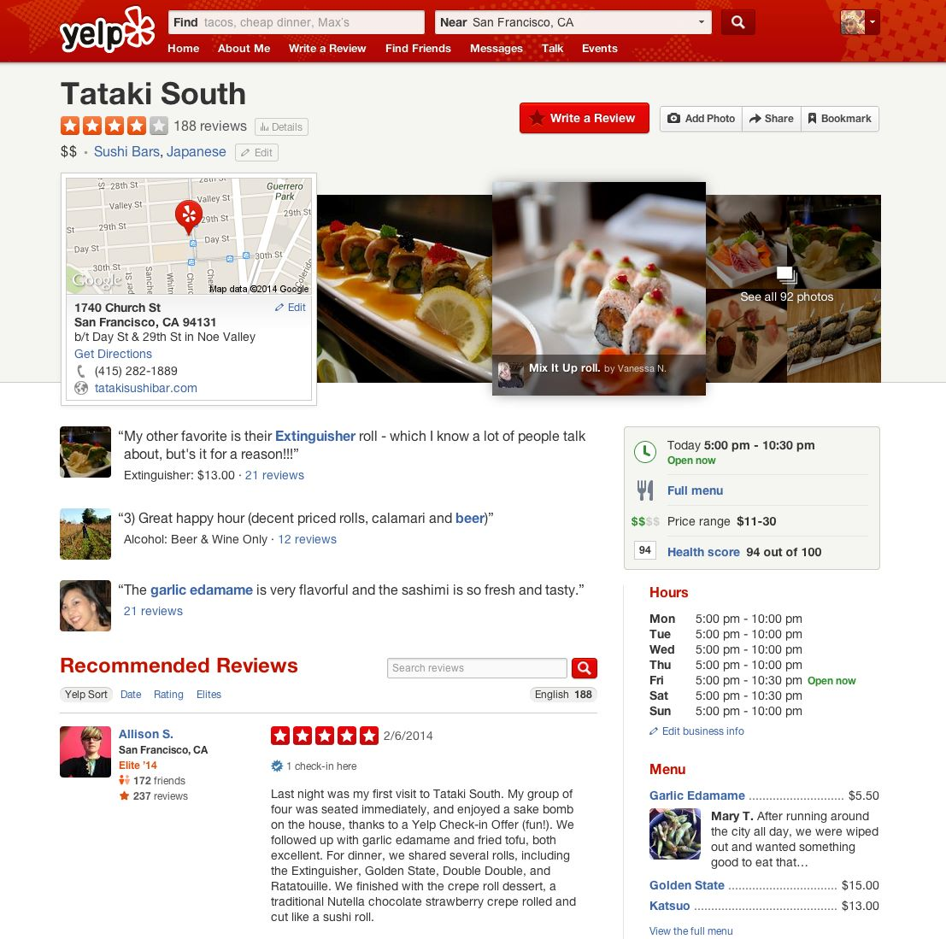
Abstract
The Yelp Open Dataset provides information on a variety of businesses such as restaurants, bars, hotels, and coffee shops.
There are millions of user reviews, but these are not usable in their current state.
By analyzing customer review data and star ratings, we will suggest businesses to improve in areas such as food quality, ambiance, and parking.
Our analysis will help increase customer loyalty and retention by providing insights into areas for improvement.

Slide 3
Data source
The Yelp dataset is a subset of
Businesses
User reviews
user profile
Data Attributes
47 unique dimensions
5 Tables.
More than 6,990,280 user reviews.
More than 100,000 businesses.
Dataset Size : 8.65 GB
Data source: https://www.yelp.com/dataset

Slide 4
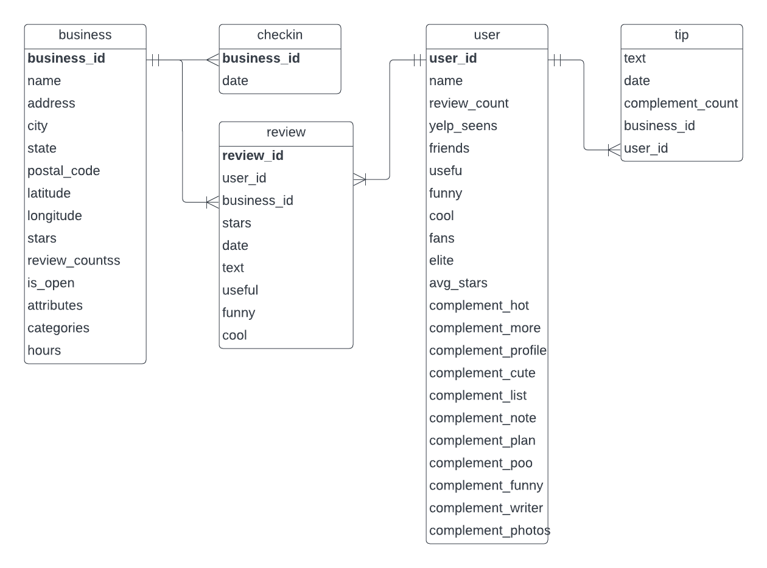
ERD

Slide 5
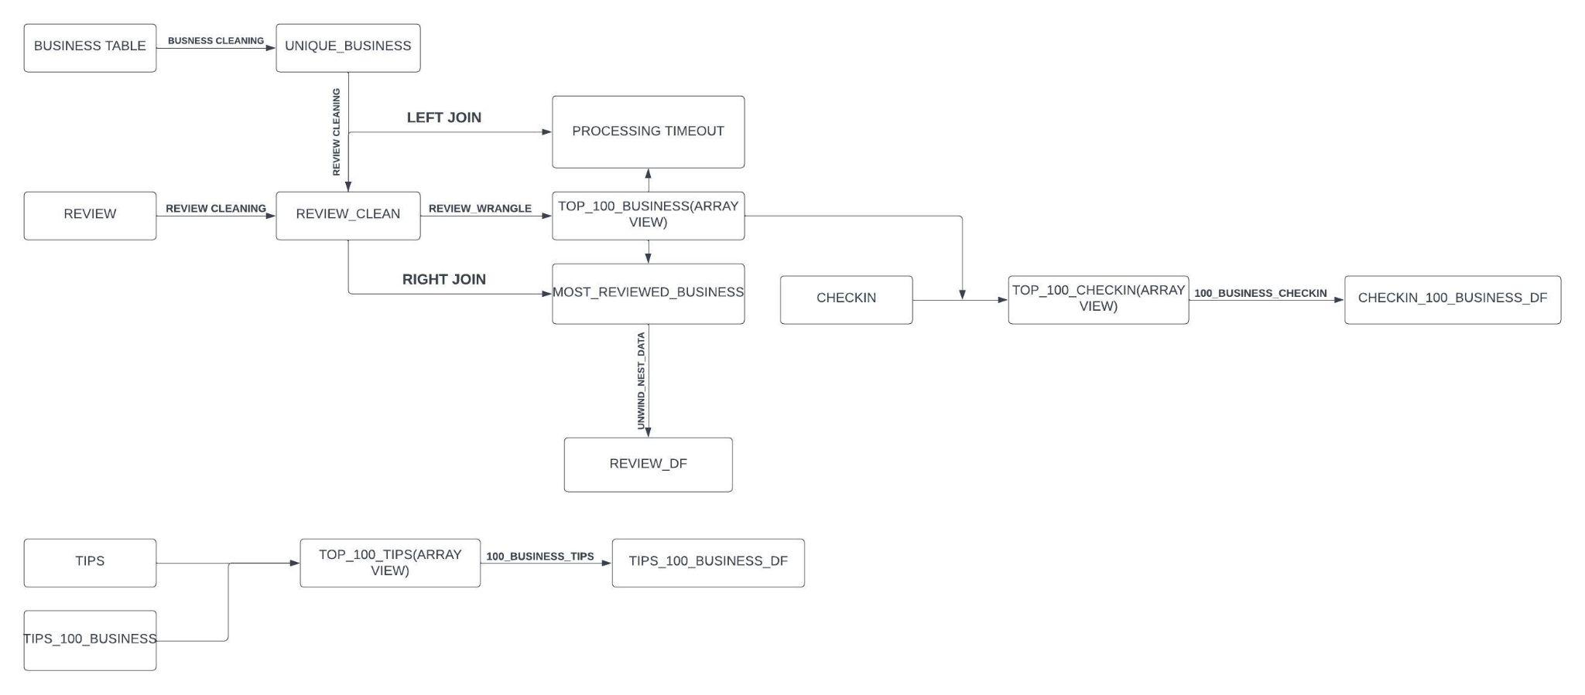
Data Preprocessing

Slide 6
Challenges Faced
Data Loading was not straightforward.
Spark was unable to process large amount of text data.
MongoDb was much better at cleaning large number of data.
Sentiment Extraction was very time taking.
Exporting data out of Databricks community edition is a hassle.
Solution: Larger Cluster

Slide 7
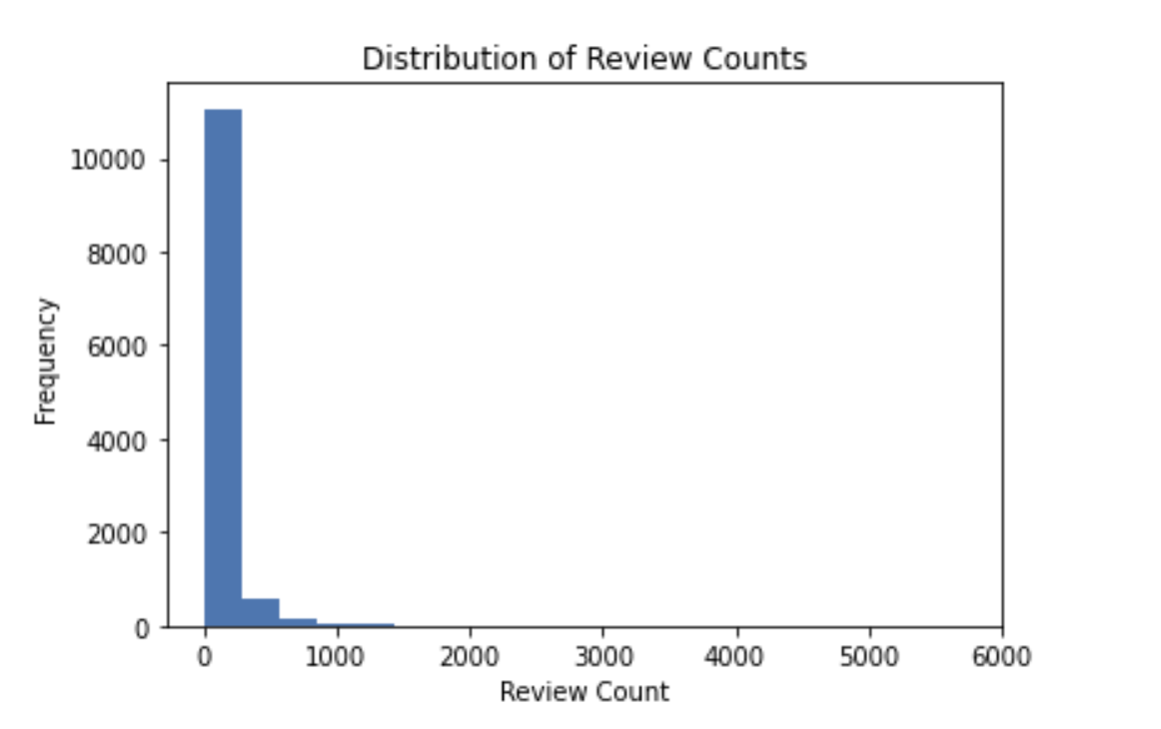
EDA

Slide 8
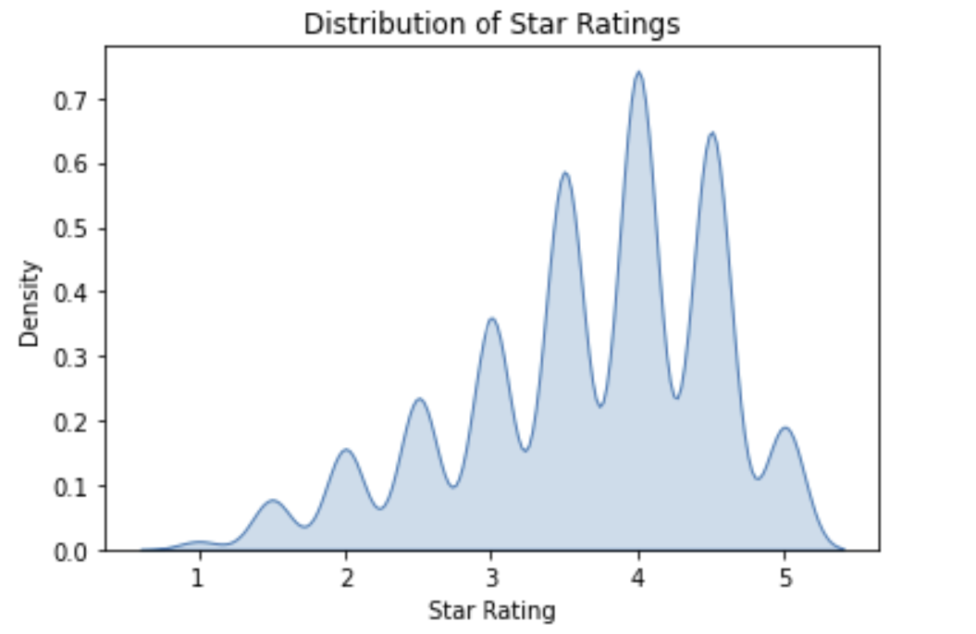

Slide 9
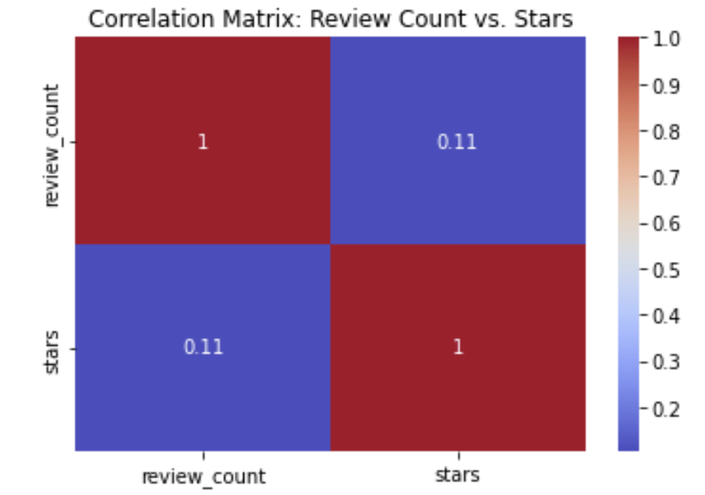
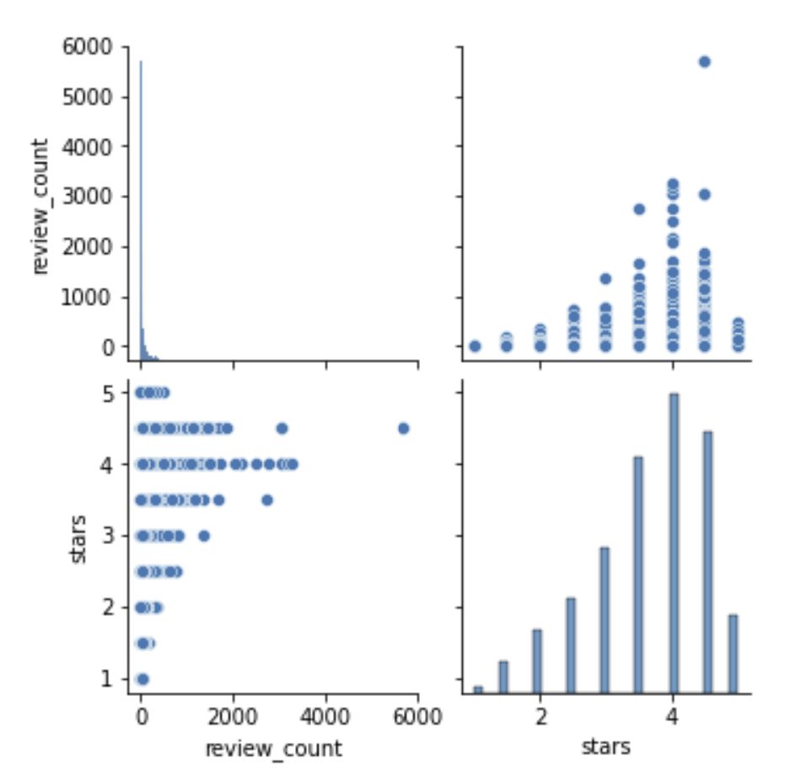

Slide 10
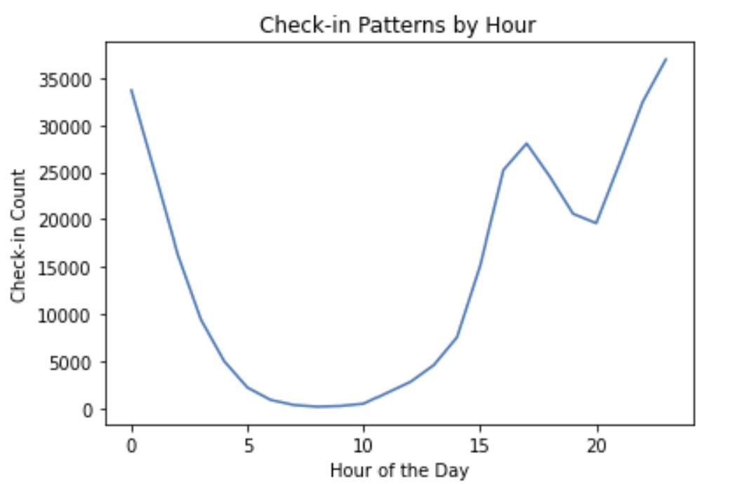
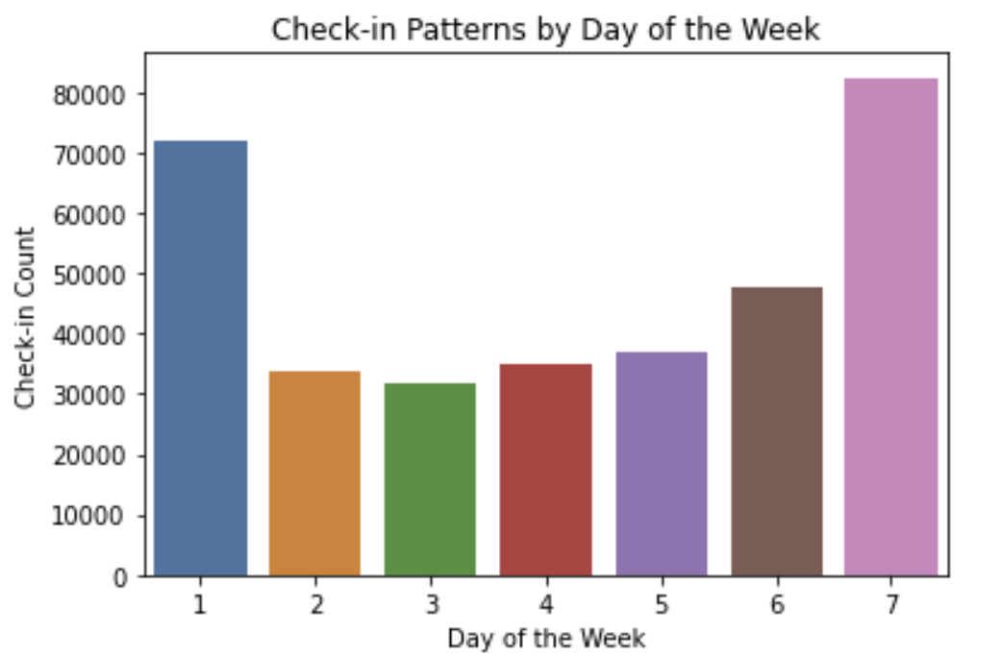

Slide 11
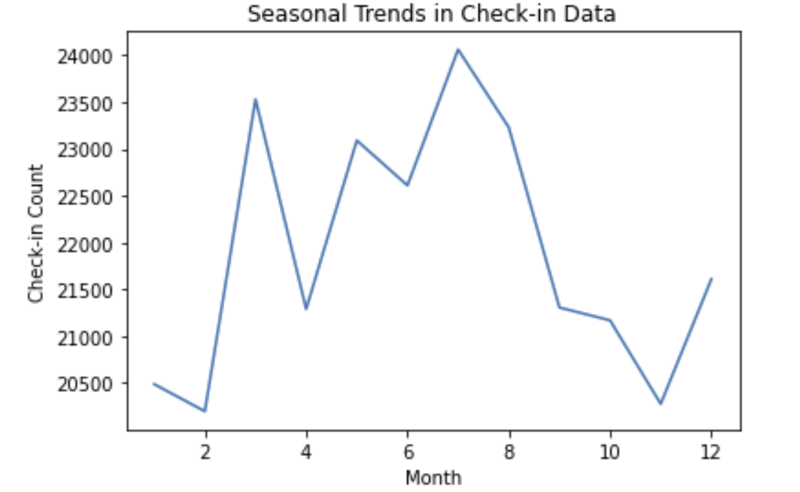

Slide 12


Slide 13
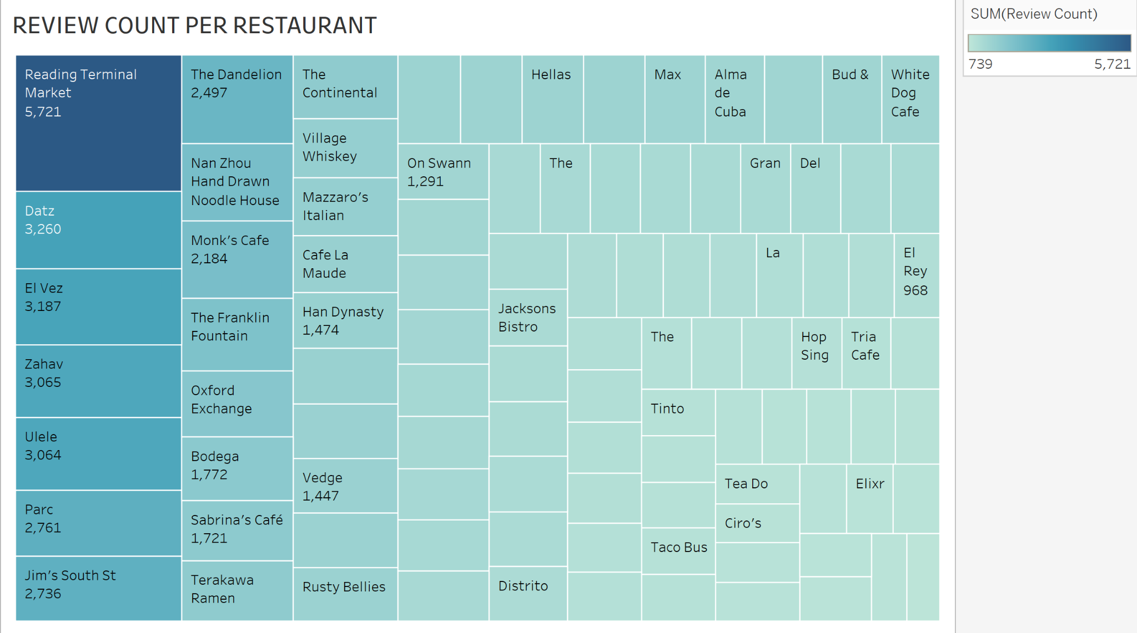

Slide 14
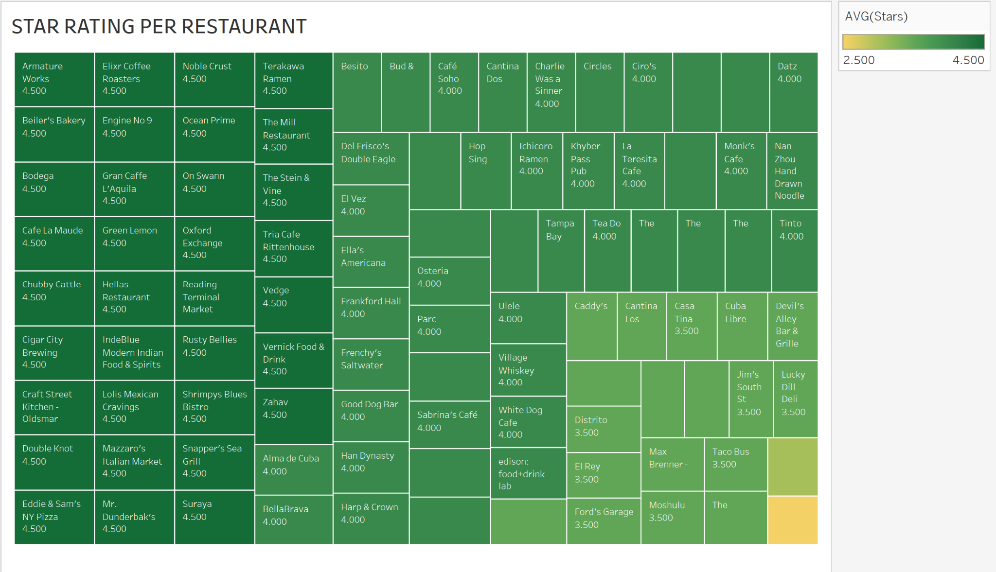

Slide 15
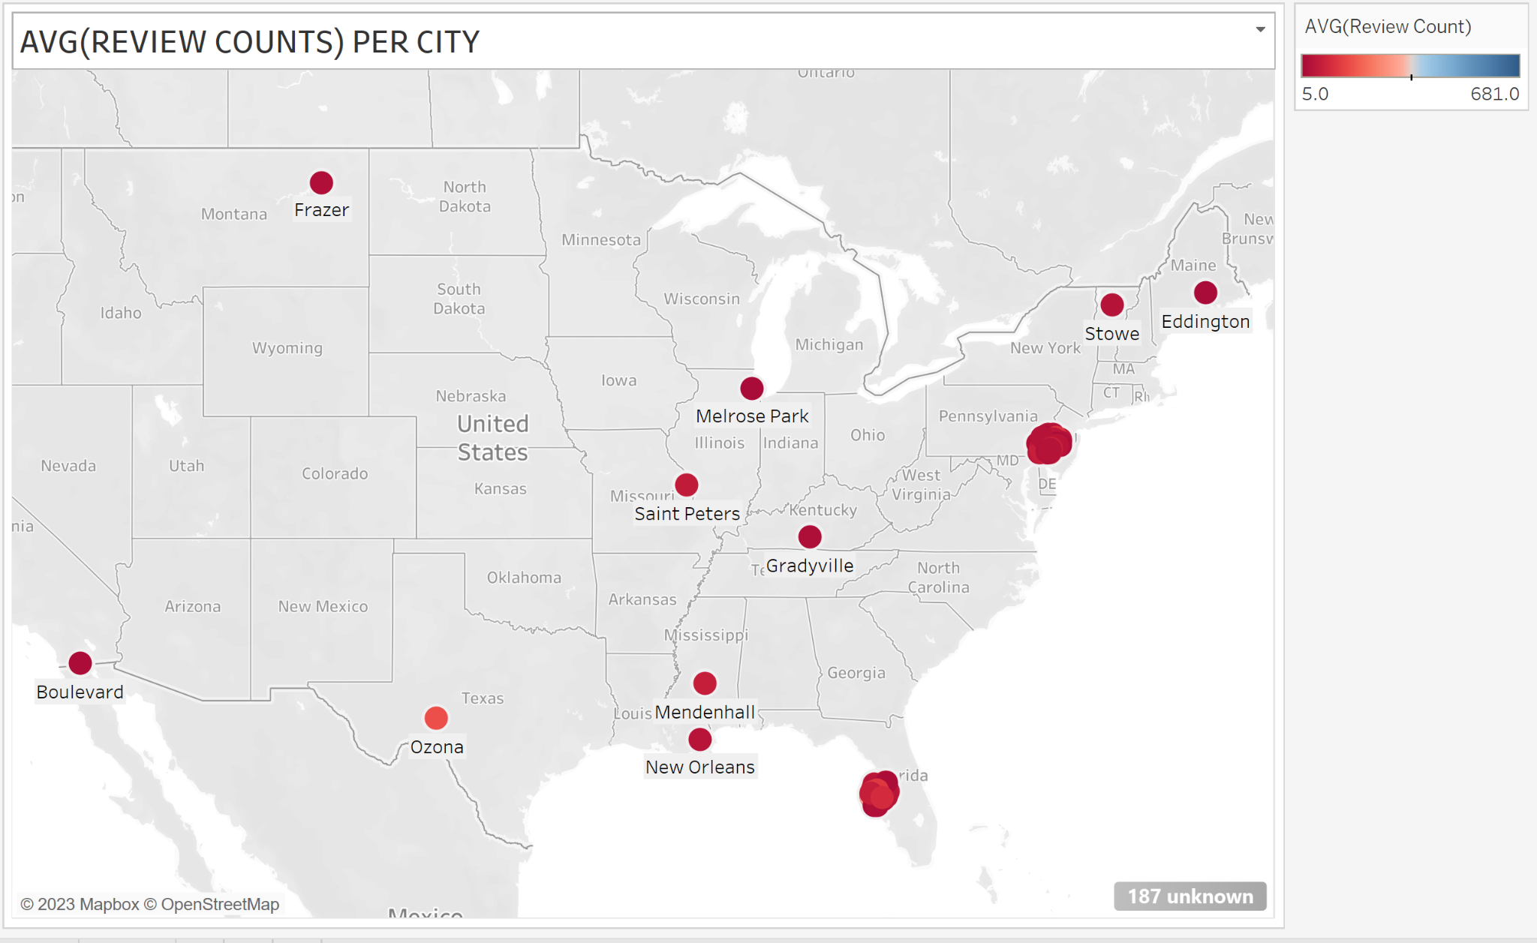

Slide 16
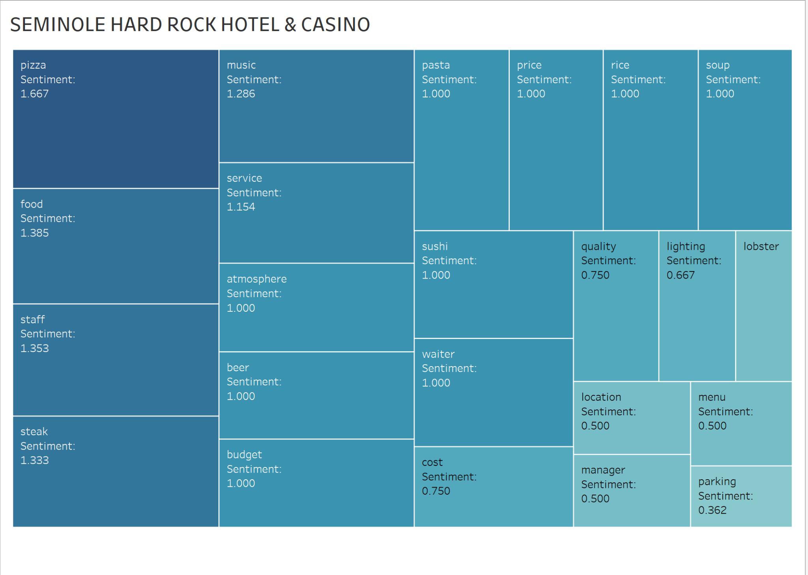
LEAST RATED RESTAURANT

Slide 17
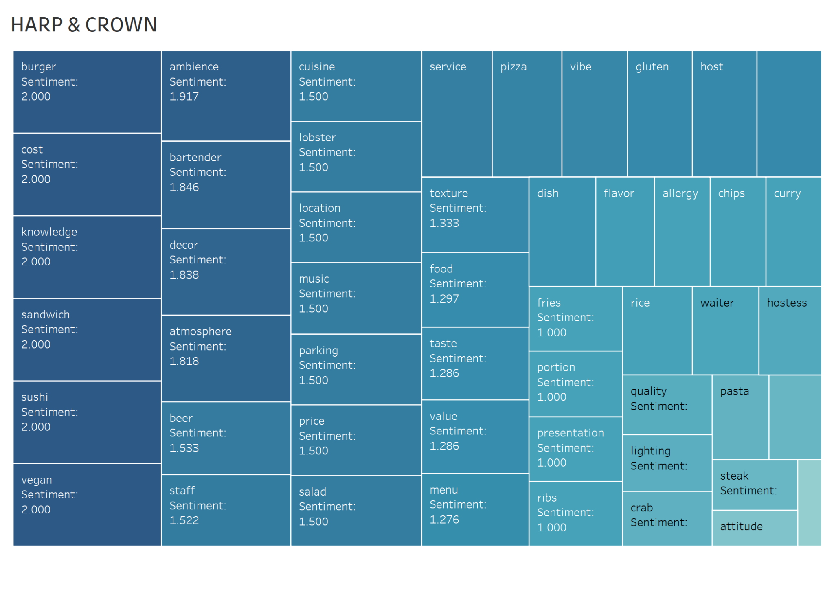
AVERAGELY RATED RESTAURANT

Slide 18
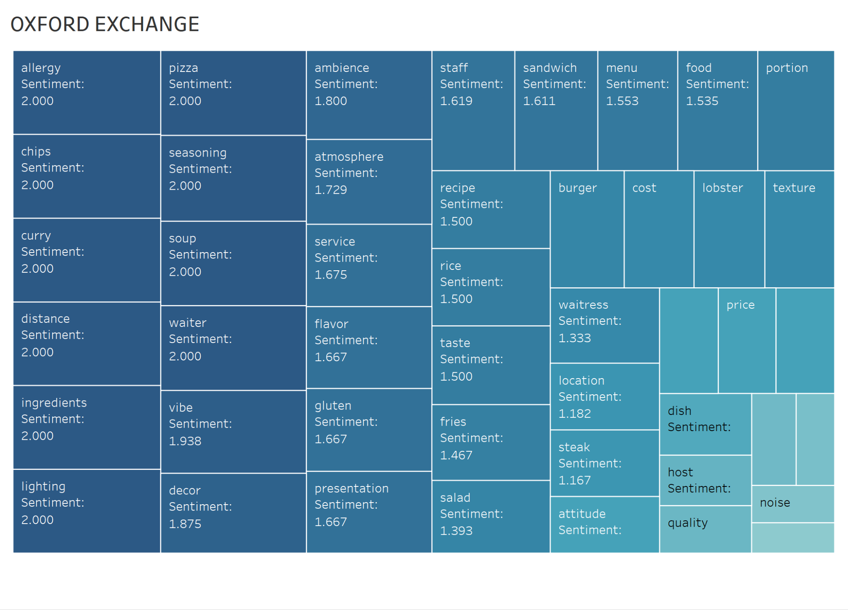
HIGHEST RATED RESTAURANT

Slide 19
Conclusion
No correlation between number of reviews and rating (popular restaurant need not be the best).
The Best restaurants cater to food allergy and offer great service.
Both averagely and best rated restaurants had a poor manager sentiment (needs further investigation).
People love Pizza and Burger.
Sampled restaurants had poor sentiment towards the staff i.e (Waitress, Waiter, Manager).

Slide 20


